Slide 1
Improve Open Source Development Impact
Ibrahim Haddad, Ph.D.
Twitter: @IbrahimAtLinux
Web: IbrahimAtLinux.com

Slide 2
Abstract
Enterprise open source development and involvement has its own set of challenges, but it becomes easier if you have a clear plan to follow. If you're one of the growing list of companies that relies on open source software for their products and services, investing time and money into improving your open source practices can pay off immensely in the long run. Fortunately, there are many success stories of companies getting involved and becoming leaders in various open source domains that they charted a path you can follow to improve your own contributions and aim for a leadership role.
This talk offers a practical guide to a number of practices that enterprises can adopt to help them grow their footprint in open source projects. We also offer an overview of the experience with Samsung’s open source group and some of the lessons learned throughout this experience.

Slide 3
Why open source?

Slide 4
Another tool in your tool box
Open source software allows shared development and lowers R&D cost by enabling you to reap the benefit of billions of dollars of open source software that can be harnessed to create better products and services.
Open source software helps accelerate product development and enables faster time to market especially when products needs and requirements are aligned with upstream open source projects.
Open source software development can also enable you to drive industry leadership by providing strong influence on the technologies used in products. This can help commoditize competing products and services as open source replaces critical components of innovation ecosystems.
Participating in open source development gives you an edge in the talent war because organizations with strong open source R&D attract top software talent.
Academic Research
Open Source Collaboration
Corporate VC
Industry Collaboration
Startup Ecosystem
Internal R&D

Slide 5

Software, Software, Software
Open Source is Eating the Software World
Much like how “location, location, location” is the foundation for value in real estate, software has become the defining value factor in virtually every industry.
Looking at vertical software stacks across most industries, we find the use of open source to be astounding, ranging anywhere from 20 percent to 85 percent or more.
No matter what industry you are in or what product or software you develop, you likely have a high reliance on open source software.

Slide 6
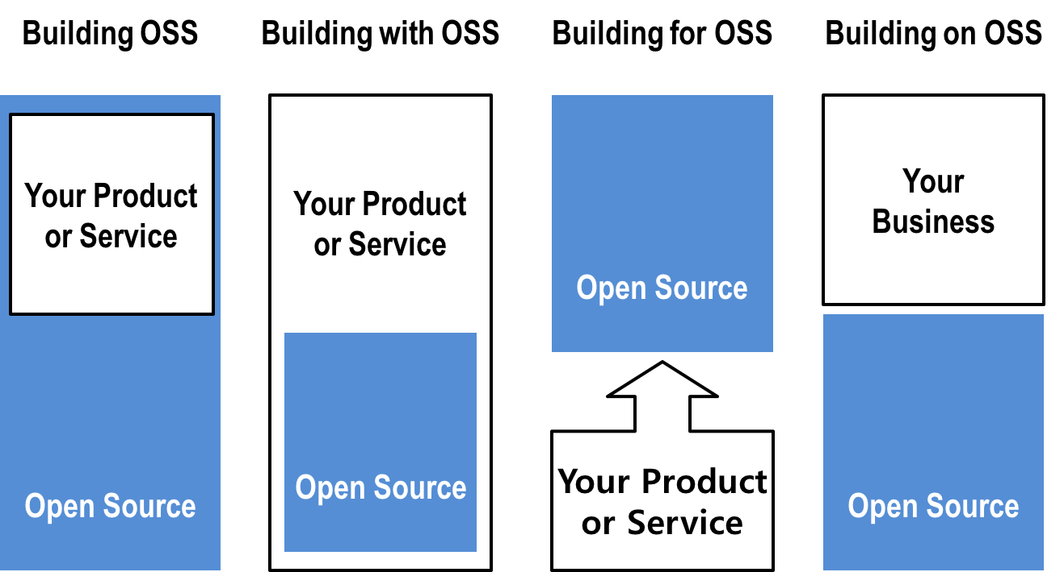
Adaptability to Various Business Models
If you put specific license requirements aside, open source software supports a variety of business models.
These use cases are proven and have remained true for some time now, but their separation is mostly for illustration purposes. Hybrids of these models also exist, and these depend on a company’s specific products or services strategy; it is common to find a company that uses multiple modules

Slide 7






















Product Dependency
Organizations can rarely build a product without using open source.
Virtually everything we build relies on open source in some way or another, and this also applies to enterprises that use software as part of their commercial offering.
If you have valuable products that rely on open source, would you want to turn your back on billions of dollars worth of R&D?
7

Slide 8
More Focused, Faster Path to Innovation
Open source software is often used at lower levels of the software stack because these are the areas with the most in common between organizations. Better use of these low-level components allows you to focus your own resources on differentiating at higher levels in the software stack and improve upon the unique value you provide to your consumers.
This is a fundamental business advantage that open source software enables. To examine this concept, consider the following:
Do people buy your products because of the specific software libraries you use in them? Probably not.
Freeing yourself from building low-level components frees up valuable resources to create value in the places customers care about the most.

Slide 9
Product Enablement
Direct enablement
Fulfill open source development requests from R&D and product teams.
Implement and upstream related drivers.
Indirect enablement
Stabilize upstream projects used in products.
Participate in internal policy discussions .
Effectively influence the upstream projects via thought leadership and code contributions.
Upstream development enables better products
Less work for product teams.
Improved reputation in upstream projects.
Faster development cycles.
Upstream internal code into open source projects.
Minimized cost to maintain source code.
Better quality code.
More stable code bases.
Participate in upstream technical discussions.
Support open source compliance efforts.

Slide 10
Open Source R&D Is an Innovation Enabler
Academic Research
Industry Collaboration
Open Source Collaboration
Internal R&D
Innovation pipeline
New technologies
and products
Corporate VC
Startup Ecosystem

Slide 11
Develop your open source strategy

Slide 12
The product is always the center
There are many questions to answer when determining your open source strategy, and they should be answered early in the process.
An open source strategy should address four key requirements:
The open source projects it aims to address,
The respective open source project community it aims to engage with,
The internal enterprise open source governance, and
The internal enterprise culture and whether or not it will be enabler of open source efforts.
Culture
Projects
Products
Governance
Community

Slide 13
Strategy objectives
Although you can choose from several strategy objectives, some objectives are common for most companies that use and develop open source software:
Reduce development costs.
Improve the quality and flexibility of products,
Achieve a faster time to market for products,
Increase engineering capacity through community engagement,
Broaden and deepen developer community commitment to your open source efforts.
Common benefits seen by customers of companies that use and contribute to open source software include:
Lower cost products and applications,
Higher quality and more reliable products and applications,
New products, capabilities and applications delivered to the market sooner

Slide 14
How can an open source strategy help you achieve your IP strategy?
Open source licensing is different from proprietary licensing and your company must account for how differences in licenses affect your ability to benefit from the use and development of open source software.
The objectives you set can include any of the following:
Determine a licensing strategy that best allows the company to benefit from external involvement while enabling better proprietary products.
Mitigate intellectual property risk by ensuring compliance with open source software used in products and services.
Enable greater differentiation in proprietary intellectual property.

Slide 15
How can an open source strategy help you grab opportunities that are otherwise unattainable?
Open source also offers some unique opportunities that are only be obtainable through an open source strategy.
Common objectives that fall under this category include:
Provide market leadership by focusing R&D investment to improve key open source technologies that are complementary to differentiated capabilities in products.
Defend existing market positions by supporting key open source initiatives and consortia, selectively releasing proprietary capabilities as open source to disrupt competitors or competing markets, and use open source to level the technology playing field.
Drive cost of goods sold improvements by incorporating readily available open source commoditized capabilities and market accelerators in products. The cost per product delivered will decline over time in as a result.

Slide 16
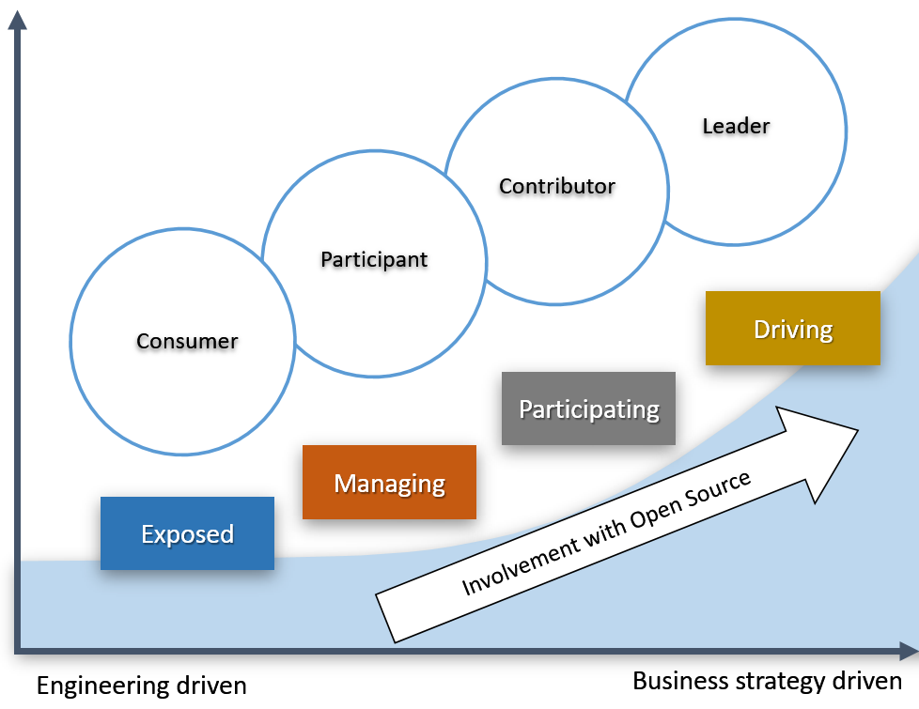
Starting Point: Identify Current and Target Position on the Open Source Strategy Ladder

Slide 17
Strategy: Open Source Consumption
The most common starting point for organizations is as an open source software user in their commercial products. Aggressively consuming open source components will increase your ability to differentiate and reduce overall time and cost to deliver commercial products.
Here are the necessary components of the open source consumption strategy:
Use a strategic classification scheme to guide decisions on what open source software to consume.
Ensure the company meets all obligations of its use of open source software.
Deploy automated workflow software for evaluating/approving open source usage.
Establish an Open Source Review Board (OSRB) immediately to serve as a clearinghouse for all Open Source activities.
Create incremental investment in headcount and infrastructure in engineering, product management, and legal to manage a complex mix of closed source / open source software.

Slide 18
Strategy: Open Source Participation
Once your company is successfully using open source software in products or services, you can expand your strategy to participate in the open source community. Unless you have already hired experienced developers from the community, you will first need to engage more closely with the community to increase your visibility and to begin attracting the talent you need.
Here are the necessary components of the open source participation strategy:
Monitor community communication platforms like chat servers, mailing lists, forums, and websites to stay informed about project developments.
Attend relevant conferences and meetups to establish a relationship with the community.
Sponsor project events and foundations to improve visibility within the community.
Educate developers on how to participate in and contribute to open source projects

Slide 19
Strategy: Open Source Contribution
Once you are ready to build on your company’s participation and begin contributing code to an open source project, you need to selectively engage with targeted projects and communities to drive you company’s needs.
Contributing to strategic open source projects can help your organization gain additional value as code contributions can help shape future features in the project that meet a company’s needs.
Here are the necessary components of the open source contribution strategy:
Hire a staff director to lead open source strategy and manage the OSRB.
Hire contributors and committers to key open source communities that are critical to your products.
Deploy open source collaboration tools to support open source usage and contributions.
Add open source developer resources.
Incrementally invest in engineering, product management, and legal to engage with existing external communities.

Slide 20
Strategy: Open Source Leadership
This scenario builds on all of the prior scenarios to capitalize on emerging trends in technology to establish a leadership position.
This scenario requires significant investment in targeted open source communities and consortia to establish leadership agenda. It will also require incremental investment primarily in engineering, product management, and legal to establish leadership in external communities and industry consortia.
Here are the necessary components of the open source leadership strategy:
Increase engagement with targeted open source communities.
Selectively engage with open standards to drive the company’s needs.
Engage with open source foundations.
Establish an open source project, organization, or foundation.
Incrementally invest in engineering, product management, and legal to engage with existing external communities.

Slide 21
Transitioning
As an enterprise, you are evaluating, using, and deploying open source software already.
You are likely participating and maybe even contributing to projects too. Ideally, your open source program is guiding these efforts, abating risks and leveraging your participation to benefit your strategy.
Leader
Open source organization
Contributor
Starting new initiatives
Increased interactions
Major, more scaled contributions
Participant
Involvement/Efforts
Interacting with communities
Minimal contributions
Consumer
Deploying
Using
Evaluating
Time

Slide 22
Implement your open source infrastructure

Slide 23
Introduction
Once you have identified your company’s open source strategy, you need to build infrastructure to support your open source engineering efforts.
There are four key pillars your infrastructure needs to support:
Consumption
Compliance
Contribution
Community
The community is unique within these pillars because it involves all interactions between the company and the specific open source projects that the company is involved in from a consumption, compliance, and contribution aspect.
Contribution
Community
Compliance
Consumption

Slide 24
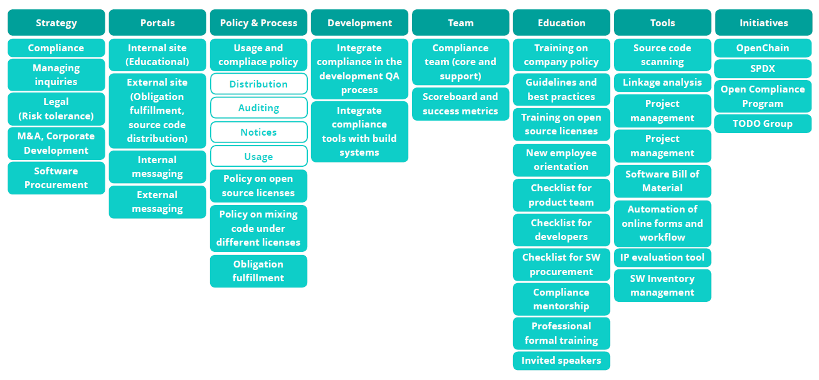
Open Source Consumption and Compliance Infrastructure

Slide 25
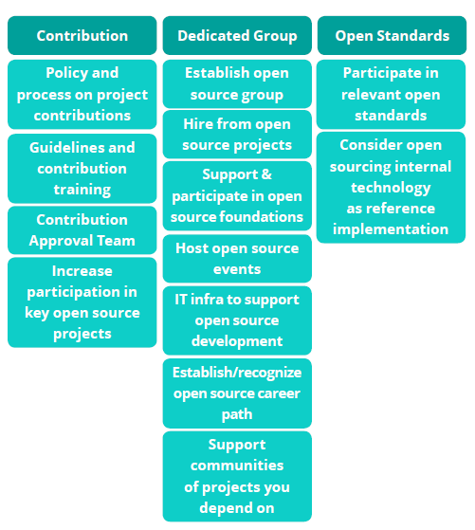
Open Source Contribution Infrastructure

Slide 26
Recommended practices

Slide 27
1/17
Create your open source program office

Slide 28
2/17
Hire or promote a leader for the open source office

Slide 29
3/17
Identify your reliance on open source software
What components are you using? Where?
How important are they to your software stack/product/service?
One option is to focus on software used by many business units or incorporated
in several products. Such an approach will allow you to show a return on investment
across multiple business units or across high risk areas.

Slide 30
4/17
Identify current and target open source position
Consumer, Participant, Contributor, Leader.
Each position requires a specific set of investment and action plan.

Slide 31
5/17
Develop and execute an open source strategy
Technical, legal, product, ecosystem and business considerations.
Open source strategy is a core component of any software strategy.
How can open source strategy accelerate your organization?
How can an open source strategy help you achieve overall corporate objectives?
How can an open source strategy help you achieve your IP strategy?
How can it an open source strategy help you grab opportunities that are otherwise unattainable?

Slide 32
6/17
Implement an open source enabling environment
Policies, processes, tools, development environment, dedicated team, educational resources, open standards, open source foundations, compliance initiatives, communication, human resources, etc.

Slide 33
7/17
Provide a flexible open source friendly IT infrastructure

Slide 34
8/17
Build expertize in key open source technical areas, ecosystem, community and strategy

Slide 35
9/17
Create meaningful metrics to track your progress
If you can’t measure it, you can’t improve it.
Some exceptions apply!

Slide 36
10/17
Create and outsource open source training
Create training on company strategy, policies, guidelines, etc.
Outsource technical and development training.

Slide 37
11/17
Establish relationships with open source foundations
Get involved.
Become a member.
Influence discussions, policy making, be in the know, etc.

Slide 38
12/17
Establish a framework for open sourcing internal code
Policy, process, due diligence (technical, business, legal), checklists, tooling, etc.

Slide 39
13/17
Encourage internal collaborations and enable them via inner sourcing practices

Slide 40
14/17
Participate and host open source events
Be visible.
Show your work.
Seek collaborators.

Slide 41
15/17
Establish open source R&D projects with universities

Slide 42
16/17
Update your outsourcing agreements, your M&A practices
Ensure compliance within your software supply chain.

Slide 43
17/17
Formalize an open source career path

Slide 44
Challenges

Slide 45
Challenge Areas
Culture
Processes
Tools
Continuity
Education
Development model
Collaboration
Transparency
Meritocracy
Team formation
Hiring practices
Right success metrics
Governance
Usage
Compliance
Contribution
Approvals
Operational model
IT infrastructure
Development tools
Metric tracking
Knowledge sharing
Code reuse
Strategy
Projects
Priorities
Funding
Executive support
Executive education
Knowledge transfer
Technical training
Compliance training
Mentorship program

Slide 46
Closing Thoughts

Slide 47
Closing
Open source is eating the software world; you can either watch the show or be a part of it.
Mastery of open source requires a strong strategy that encompasses open source consumption, participation, contribution, and leadership, and each of these requires their own incremental effort and investment into improving open source engineering.

Slide 48
4 key pillars
Consumption and Compliance
Participation
Establish internal infrastructure that enables proper open source practices and incorporates open source policies, processes, checklists, and training.
Begin engaging with the open source community on communication platforms and at events.
Sponsor projects and organizations that are important to open source software you rely on for your products.
Contribution
Leadership
Hire or train developers that focus specifically on open source contributions and deploy the necessary tools to support internal open source engineering.
Increase engagement with open source communities, open standards bodies, and foundations.
Launch new open source initiatives and increase your visibility in open source communities.

Slide 49
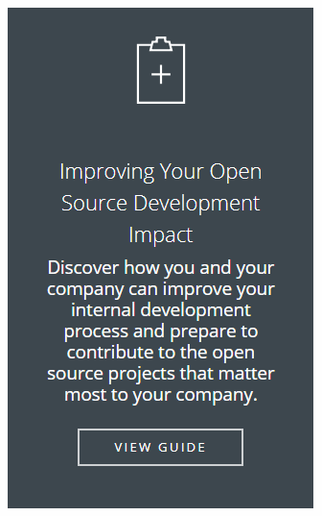
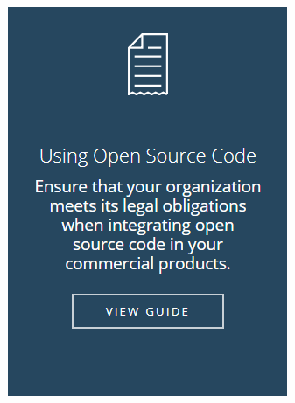
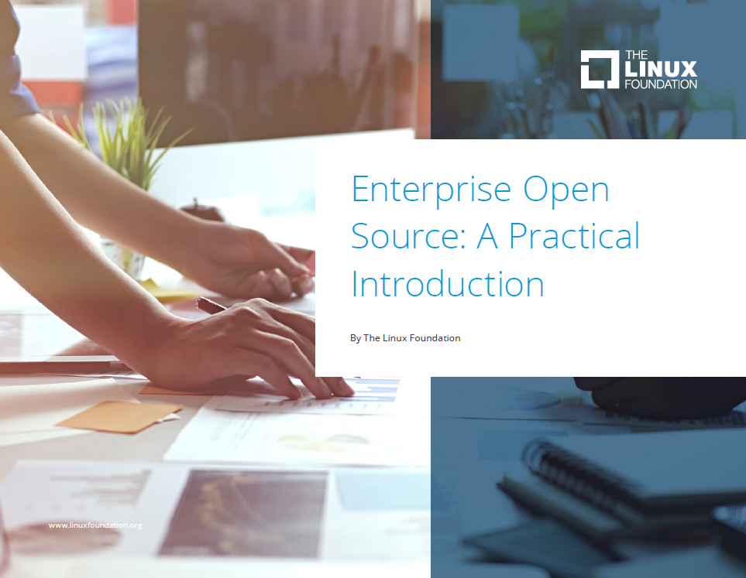
References

Slide 50
Improve Open Source Development Impact
Ibrahim Haddad, Ph.D.
Twitter: @IbrahimAtLinux
Web: IbrahimAtLinux.com

